Slide 1


Effective Reading Skills

Slide 2
MEANING OF READING
Reading is a source of thinking with another person's mind; it forces you to stretch your own thoughts. According to Francis Bacon, “Reading makes a full man, conference a ready man, and writing an exact man.”

Slide 3

Style of Effective Reading Skill
There are four styles of reading which we use in different
situations:

Slide 4
Skimming:
1
Skimming is used to quickly gather the information or for getting the gist of something that we read.
It is the technique we use when we're going through newspaperor magazine. We read quickly to get the main points, and skip over the detail. The chief uses of skimming are as follows :
To preview a passage before we read it in detail.
To refresh the understanding of a passage after we've read it in detail.
We use skimming when we're trying to decide if a book in the library or bookshop is right for us.

Slide 5
Scanning:
It is used to find a particular piece of information,for a specific focus .The technique we use when we're looking up a name in the phone book. We move our eye quickly over the page to find particular words or phrases that are relevant to the task we're doing.
2
It's useful to scan parts of texts to see if they're going to be useful to us:
the introduction or preface of a book the first or last paragraphs of chapters the concluding chapter of a book.

Slide 6
Extensive reading It is used to obtain a general understanding of a subject . It includes reading of longer texts for pleasure, and business reports to know about the general trends.
3

Slide 7
4. INTENSIVE READING
It is used on shorter texts in order to extract detailed information.
It includes close and accurate reading for details.
It is important to understand each word, information or fact.

Slide 8


Purpose of Effective Reading Skill
The Three Reading Purposes:
REVEAL
REVIEW
REMIND

Slide 9
Strategies for Make Reading Effective
Connect to the Text
Ask Questions
Expand Vocabulary
Predict & Prove
Sense It
Decide What’s Important
Make Inferences Then Draw Conclusions
Summarize and Synthesize
Check Your Understanding
Build Fluency

Slide 10
PROCESS OF Effective Reading Skill
Feeling right about reading
Develop the 3Rs of reading-Reveal, Review, Remind
Become a more selective reader
Become a smarter reader
Become a more focused (and faster) reader
Become a more active reader

Slide 11
7 GUIDLINE FOR EFFECTIVE READING
Define Purposes and Participants
Clearity about Environment
Identify Reading Channel
Control Interference
Getting the Meaning of Words and non- verbal Symbols
Get feedback
Evaluate Critically

Slide 12

7 Tips For Improvement of Effective Reading Skill
Distinguish between total understanding and overall impression
Set a time limit
Ask yourself what you already know about the topic
Read with a purpose
Skim through first
Read summaries first
Make notes as you go

Slide 13
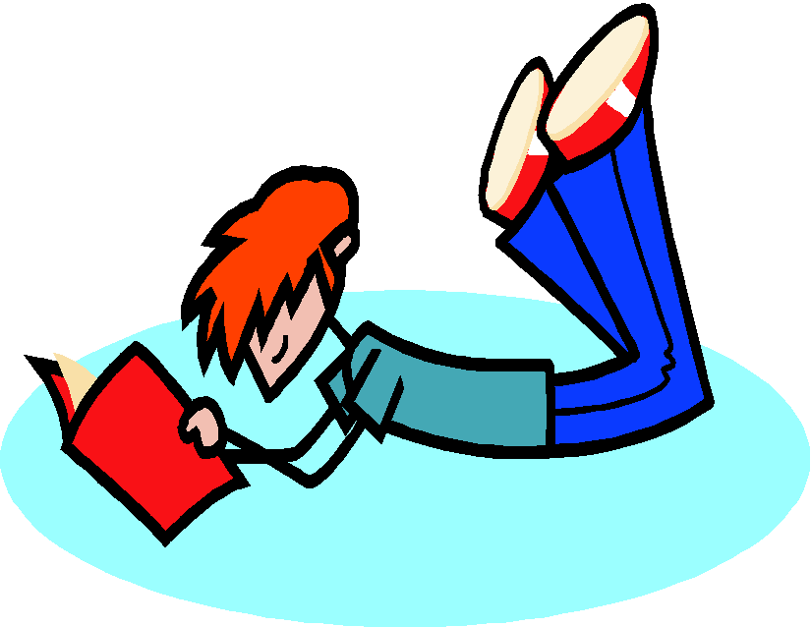

THANK YOU

